Slide 1
Compilation Techniques (10)
Code generation for expressions
Left values
Postfix form
Special cases
Short-circuit evaluation
© Codruta-Mihaela ISTIN 2015

Slide 2
Code generation for expressions
Given an expression, how can it be translated to code for a stack based virtual machine (SVM) or for a register based virtual machine (RVM)?
An expression can contain different operands (ex: ids, numbers, strings), operators (ex: arithmetic, logic, comparison), functions calls, array indexing, member access, …
All these constituents must first form an Abstract Syntax Tree (AST) according to the operators precedence and associativity
The AST can be explicit (built in memory as a data structure) or implicit (determined by the visiting order of the predicates when using a descent recursive parser)
The AST must pass the types analysis (TA) so it represents a valid expression
Information from TA (such as the resulted type of a subexpression) will be later used in code generation
© Codruta-Mihaela ISTIN 2015

Slide 3
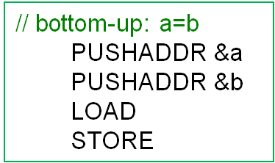
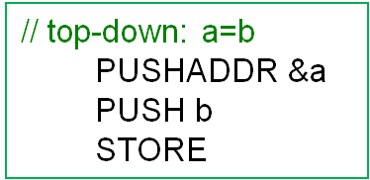

Left values
Some expressions need left values (ex: assignments “r=…”, or functions’ calls with parameters sent by address/reference)
When the left value is required, the address of the operand must be used, not its value. At AST traversal left values can be handled in different ways:
  bottom-up: as long as possible the lval is used (because lval is more general than rval) and a synthesized attribute is used to specify that. If a rval is needed, the lval is converted to rval
  top-down: an operator node sends to its children an attribute which tells what type of values it needs (ex: “=“ will send to its left child “lval required” and to its right child “rval required”). In this way when an id is encountered, its address or value will be used, according to the inherited attribute
  custom treatment: when the languages use lvals only in a few well-defined cases (ex: Pascal), these cases can be handled separately. The lval cases are separated from the rest of the expressions that will work only with rvals.
Using code optimizations the first two forms can be reduced to the third one
© Codruta-Mihaela ISTIN 2015

Slide 4
Postfix form
The resulted form when the AST of an expression is traversed in postfix order
Postfix order: first the children and then the root
A simple algorithm to manually construct an AST for an expression:
  the root of the AST is the operation which is executed last
  the children of the root are the ASTs which are constructed with the operands of the root operation
  the algorithm is repeated recursively until there are no more operations
© Codruta-Mihaela ISTIN 2015

Slide 5
Postfix form example
r=2*k*max(sin(a[i]+PI/2),0.5)
=
r
*
*
max
2
k
sin
0.5
+
[]
/
a
i
PI
2
r 2 k * a i [] PI 2 / + sin 0.5 max * =
© Codruta-Mihaela ISTIN 2015

Slide 6
Postfix form evaluation
The most important property of a postfix form is that it can be evaluated in the exact order of its constituents using a stack
Evaluation algorithm:
  if an operand (ex: id, constant) is encountered, it is pushed on stack
  if an operator or function is encountered, the operation is made on stack by taking the necessary number of arguments from stack and the result is pushed on stack
  the algorithm is repeated until there are no more constituents
  in the end the result will be the top value of the stack
Example: r 2 k * a i [] PI 2 / + sin 0.5 max * =
[] → [r] → [r, 2] → [r, 2, k] → [r, 2*k] → [r, 2*k, a] → [r, 2*k, a, i]
→ [r, 2*k, a[i]] → [r, 2*k, a[i], PI] → [r, 2*k, a[i], PI, 2] → [r, 2*k, a[i], PI/2]
→ [r, 2*k, a[i]+(PI/2)] → [r, 2*k, sin(a[i]+(PI/2))] → [r, 2*k, sin(a[i]+PI/2), 0.5]
→ [r, 2*k, max(sin(a[i]+PI/2), 0.5)] → [r, (2*k)*max(sin(a[i]+(PI/2)), 0.5)]
→ [r=(2*k)*max(sin(a[i]+(PI/2)), 0.5)]
© Codruta-Mihaela ISTIN 2015

Slide 7
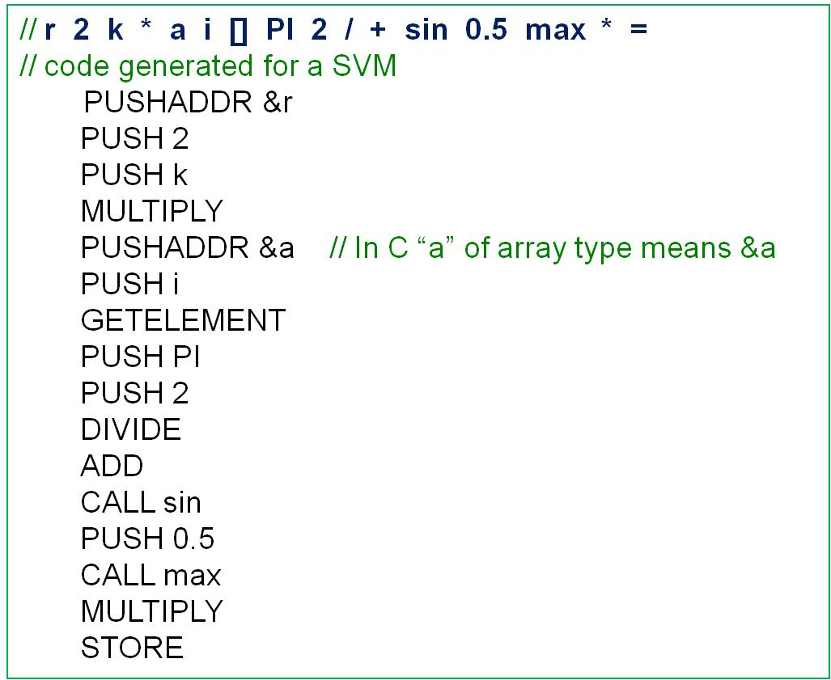
SVM code for a postfix form
© Codruta-Mihaela ISTIN 2015

Slide 8
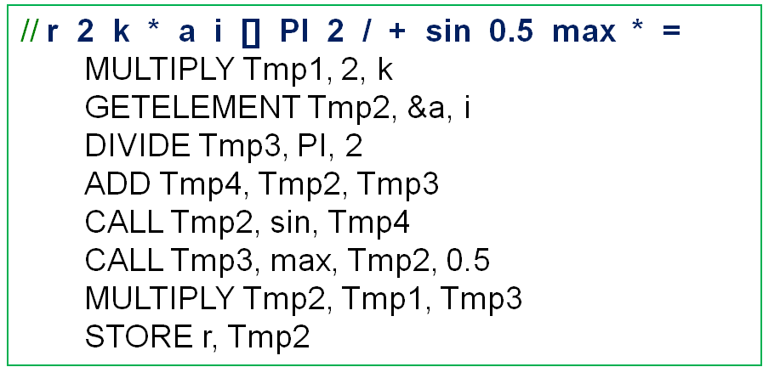
RVM code for a postfix form
For each intermediary AST node a new register (or temporary memory location) must be allocated
This register receives the result and it is further used by its parent
Optimization: because each register is used only once (by its parent), after its usage it can be reused in order to decrease the register/memory usage
© Codruta-Mihaela ISTIN 2015

Slide 9
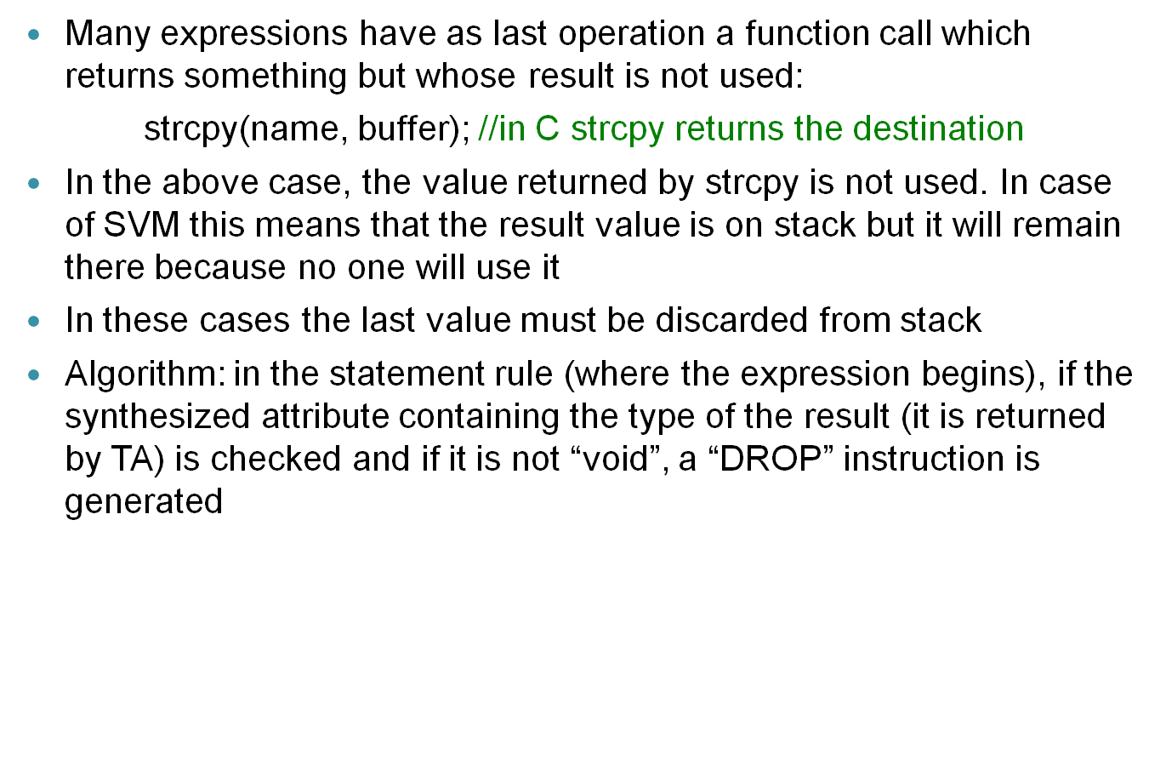
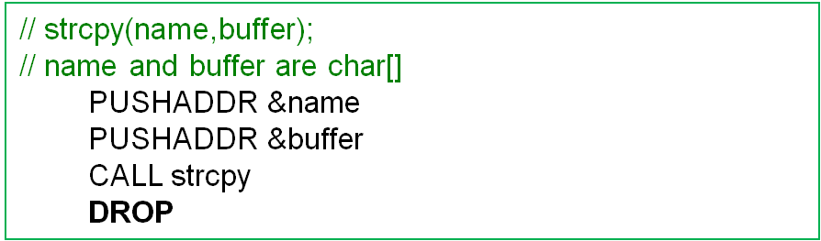
Last value of an expression
© Codruta-Mihaela ISTIN 2015

Slide 10
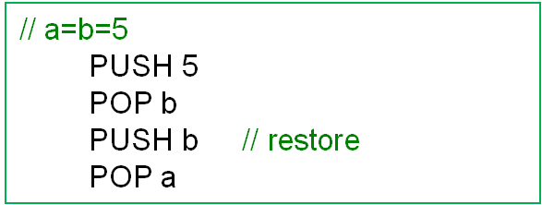
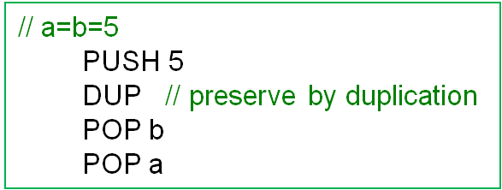
Duplicates when the result is consumed
Some operations do not leave the result on stack, for example “=“ pops the value from stack
If such operations can be cascaded (ex: a=b=5), the last value on stack must be preserved or restored
© Codruta-Mihaela ISTIN 2015

Slide 11
Functions with variable number of arguments
In languages such as C/C++: int printf(const char *fmt, …)
  the arguments are put on stack from right to left. In this way the known argument (“fmt”) is closer to FP and it is in a known position (first position near FP)
  from this known position a special iterator is used (of type “va_list”) to iterate the rest of the arguments
  the types of the rest of the arguments must be known from the required arguments (in case of “printf” by parsing the “fmt” string) or otherwise inferred, else the iterator cannot know the arguments types
  the arguments are erased from stack at the call position (the place where they are know), not at function return
In languages such as Java: double min(double…values):
  all the optional arguments are accumulated in an array
  this array is passed as a single argument
  the function can access any optional argument, in any order, by accessing this array
© Codruta-Mihaela ISTIN 2015

Slide 12
Short-circuit evaluation (SCE)
When the value of the first member of a logic expression (and, or) is known, the rest of the expression is evaluated only if necessary
Many programming languages specify SCE as standard for their logic operators. This means that SCE is a requirement, not an optional feature
Example: if(a>0 && f(b,a)!=1){…}
“a>b” is evaluated first and if it is false, “f(b,a)!=1” is never evaluated because it is known that the final result of && will be false
SCE advantages:
  speed optimization by not evaluating the second expressions (if the expressions are very simple, it is possible to appear a delay because it is easier to compute a logic operator than a jump)
  allows to guard the second expressions with preconditions; if these are not satisfied, the second expressions are not run
If the second expressions have side effects (such as modifying the value of a global variable), it must be taken into account that it is possible to not evaluate these expressions so in some cases the side effects appear and in others they do not
© Codruta-Mihaela ISTIN 2015

Slide 13
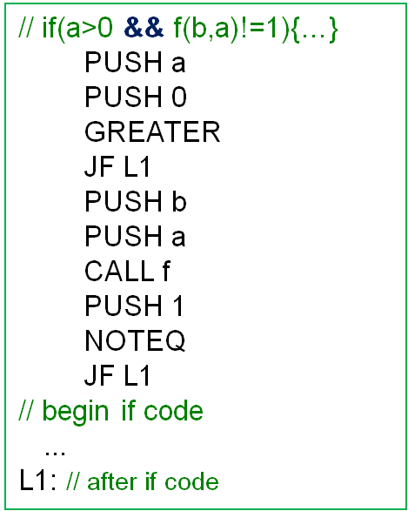
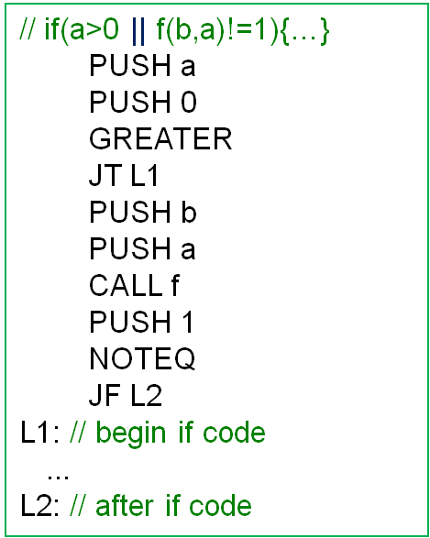
SCE implementation
© Codruta-Mihaela ISTIN 2015

Slide 14
Bibliography reading
Compilers. Principles, Techniques and Tools
2.3, 2.5, 6.4
© Codruta-Mihaela ISTIN 2015

